Slide 1

DESIGN PATTERNS
SOFTWARE ENGINEERING

Slide 2
Overview
Design patterns are proven, reusable solutions to common problems that occur in software design.
They are not code templates, but
rather descriptions or blueprints that help developers solve design issues in a consistent and efficient way.
Design Pattern = A general, reusable solution to a commonly occurring problem within a given context in software design.

Slide 3
Purpose
Promote best practices in design
Improve code readability, reusability, and maintainability
Provide a common vocabulary for designers and developers
Prevent common pitfalls in software architecture

Slide 4


Slide 5
Types of Design Patterns
Creational Patterns
Structural Patterns
Behavioral Patterns

Slide 6
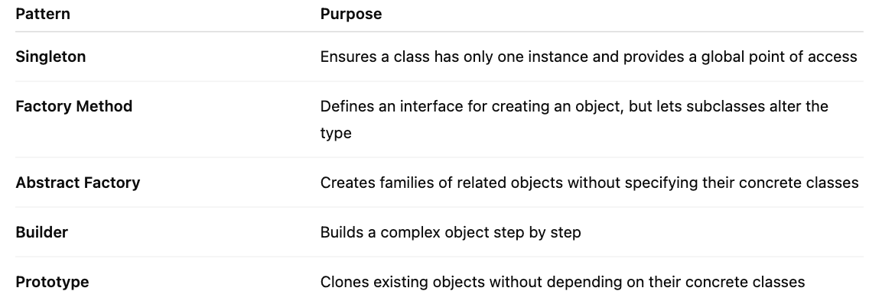
Creational Patterns - Focus on object creation, ensuring flexibility and reuse

Slide 7
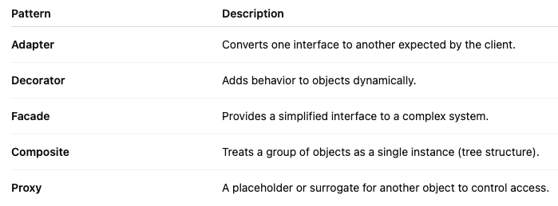
Structural Patterns - Deal with object composition — how classes and objects are combined

Slide 8
Behavioral Pattern
Focus on communication between objects
Examples:
Observer – Notifies multiple objects when one changes
Strategy – Selects algorithms at runtime
Command – Encapsulates requests as objects
Example:
Observer Pattern (Behavioral)
Imagine a news app that updates multiple subscribers whenever a news article is published.
Subject = News publisher
Observers = Users subscribed to updates
When the publisher posts new content, all observers are notified automatically.

Slide 9
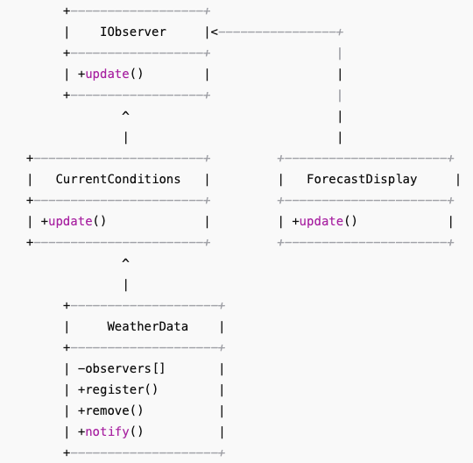
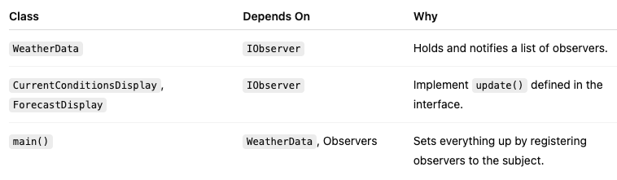
Example coding – Observer Pattern
Use Case:
You have a Subject (like a WeatherStation), and
multiple Observers (like displays or apps) that need to get updated whenever the Subject's state changes.

Slide 10
Importance
Reusability: Promotes reuse of proven design structures.
Efficiency: Speeds up development by solving common problems.
Communication: Improves communication among developers through shared vocabulary.
Scalability: Encourages modular and flexible designs.
Maintainability: Reduces code duplication and increases clarity
Reduces technical debt
Makes code easier to understand and modify
Encourages modular, flexible, and extensible architecture

Slide 11
Misunderstandings on design patterns
Not a silver bullet: Patterns don’t solve all design problems automatically.
Not libraries or frameworks: They're conceptual solutions, not plug-and-play code.
Can be misused: Applying a pattern where it doesn't fit can lead to unnecessary complexity (aka "patternitis").

Slide 12
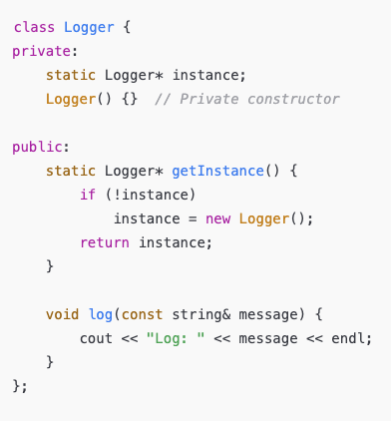
Example: Singleton Pattern (Creational)
Problem: You want only one instance of a logging class across your application.

Slide 13




Criticisms of Design Patterns
Overhead Complexity
Misapplication
Not Always Necessary
Some argue that overusing design patterns can lead to unnecessary complexity in software design, making it harder to understand.
Patterns can be misapplied if developers lack sufficient understanding of the problem domain, leading to suboptimal solutions.
In simple applications, the use of design patterns may be overkill, and simpler solutions might suffice without the need for complex patterns.

Slide 14
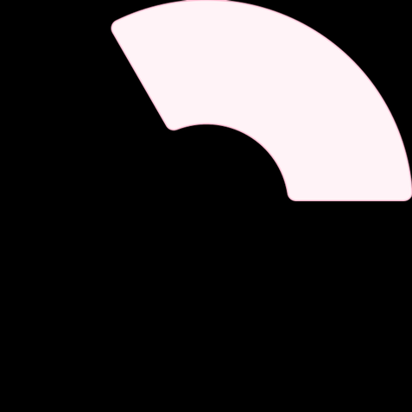


Conclusion on Design Patterns
Future of Design Patterns
As technology evolves, the adoption and adaptation of design patterns will continue to play a vital role in developing scalable and maintainable software solutions.
2
Recap of Importance
Design patterns are essential tools in software engineering that facilitate effective problem solving and enhance code quality.
1
Encouragement for Practice
3
Students and developers are encouraged to study and practice design patterns to improve their software design skills and contribute to successful software projects.

Slide 15
Applying Design Patterns
Pattern Implementation
Proper implementation of design patterns involves recognizing the appropriate scenarios for their use and ensuring that they do not complicate the system unnecessarily.
2
Choosing the Right Pattern
Selecting the appropriate design pattern requires understanding the problem context and the relationships between different components in the system.
1
Real-World Examples
3
Many frameworks and libraries incorporate design patterns, such as MVC in web applications, which demonstrate their practical applicability in software development.

Slide 16
Model-View-Controller (MVC)
In a web app;
Model: Handles the data. For example, it knows how to save and retrieve user info from a database.
View: Displays the data. For example, it shows a webpage with the user's profile.
Controller: Handles user input. For example, when the user clicks "Save," the controller tells the model to update the data and then refreshes the view.
Why use MVC?
Keeps code organized
Makes it easier to update or fix parts of the app
Helps teams work together (designers can work on views, developers on models)

Slide 17
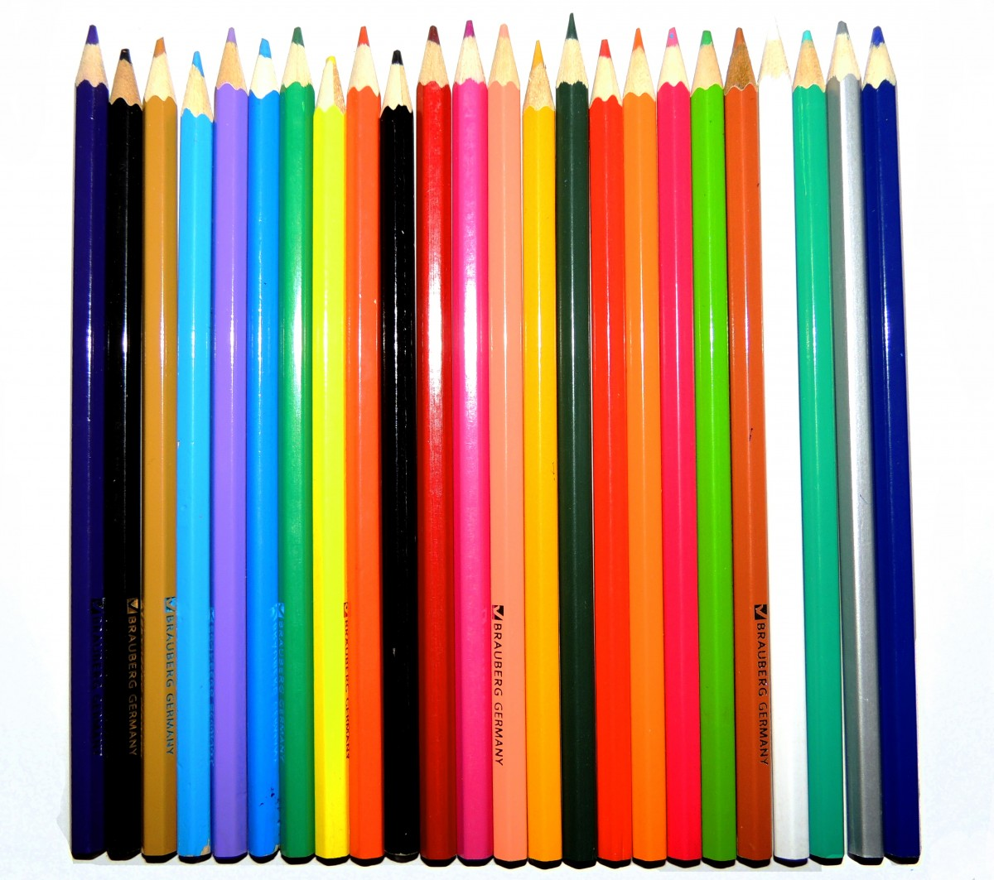

Case Study: MVC Pattern
Overview
Use in Web
Development
Benefits
1
The Model-View-Controller (MVC) pattern separates an application into three interconnected components, promoting organized code structure.
2
MVC is widely used in web frameworks like Ruby on Rails and ASP.NET, where it helps manage user interactions efficiently.
3
MVC enhances code maintainability and scalability by allowing independent development and testing of each component.

Slide 18

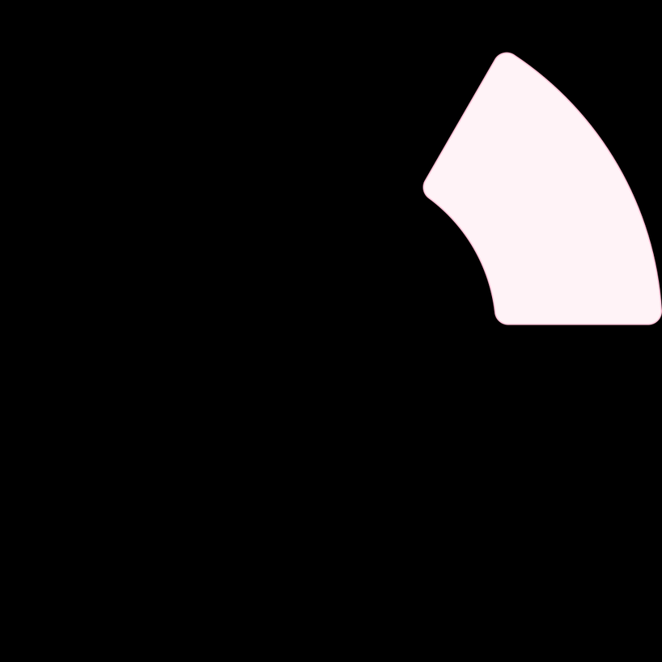
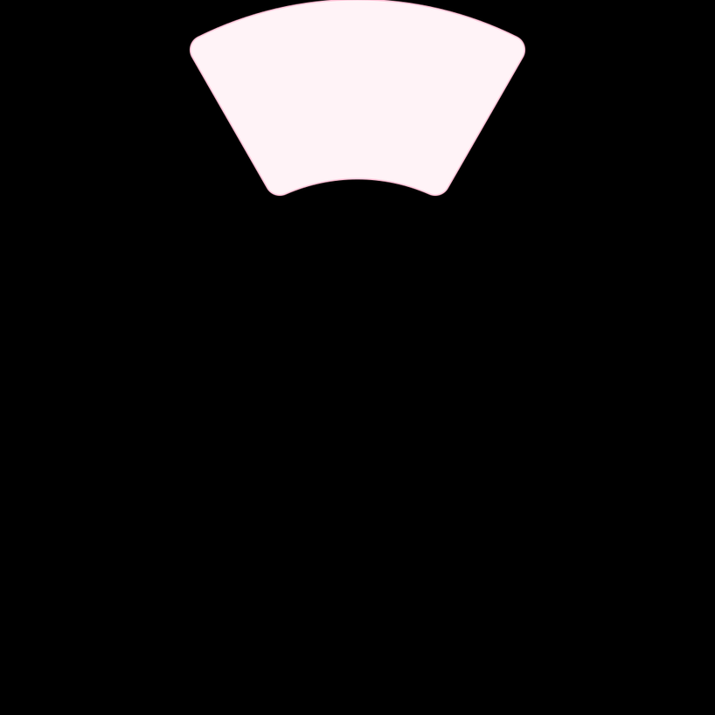
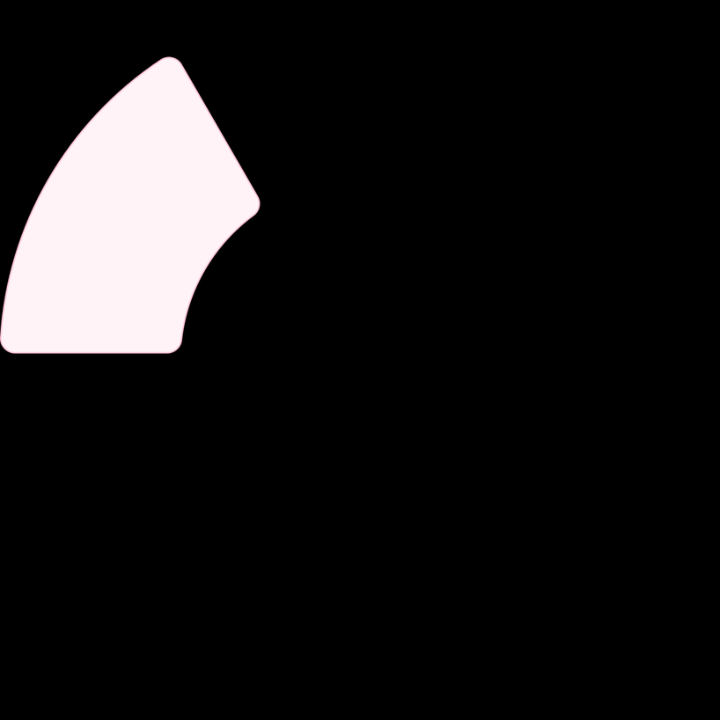
Case Study: Observer Pattern
Use in GUI Applications
This pattern is commonly used in GUI frameworks, where UI elements need to respond to user inputs or other changes dynamically.
Overview
Benefits
The Observer pattern is designed for scenarios where a subject needs to notify multiple observers about state changes.
It promotes loose coupling between components, making systems easier to maintain and extend.
2
1
3

Slide 19



Further Reading and Exploration
Advanced Patterns
Pattern Catalogs
Implementation in Languages
Explore advanced design patterns like the State Pattern, Mediator Pattern, and Visitor Pattern for more sophisticated software design solutions.
Consider consulting pattern catalogs that categorize and explain various patterns with practical examples and code snippets.
Investigate how different programming languages implement design patterns, as syntax and best practices vary widely across languages.

Slide 20
Practice
Find 2 samples coding and try to find their design pattern

Slide 21
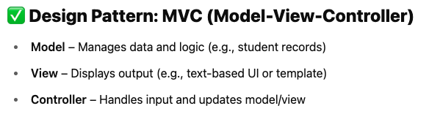
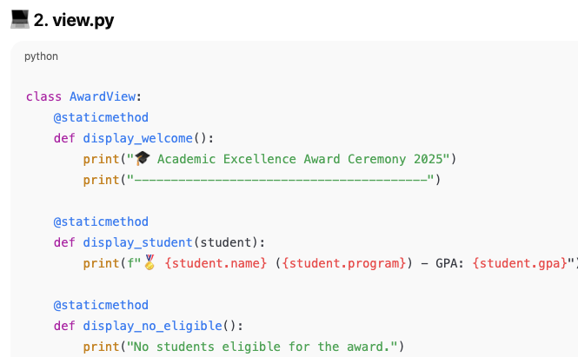
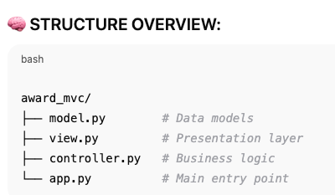
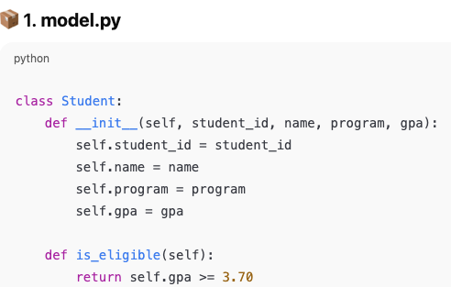
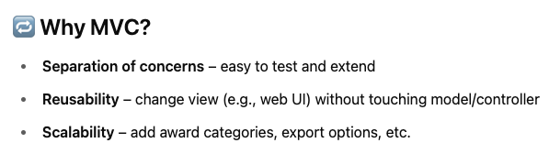
Example: Display and manage student award recipients for the Academic Excellence Ceremony
Python project that demonstrates a simple, real-world Academic Excellence Award Management System using the Model-View-Controller (MVC) design pattern — one of the most common and appropriate patterns for such applications.

